Slide 1
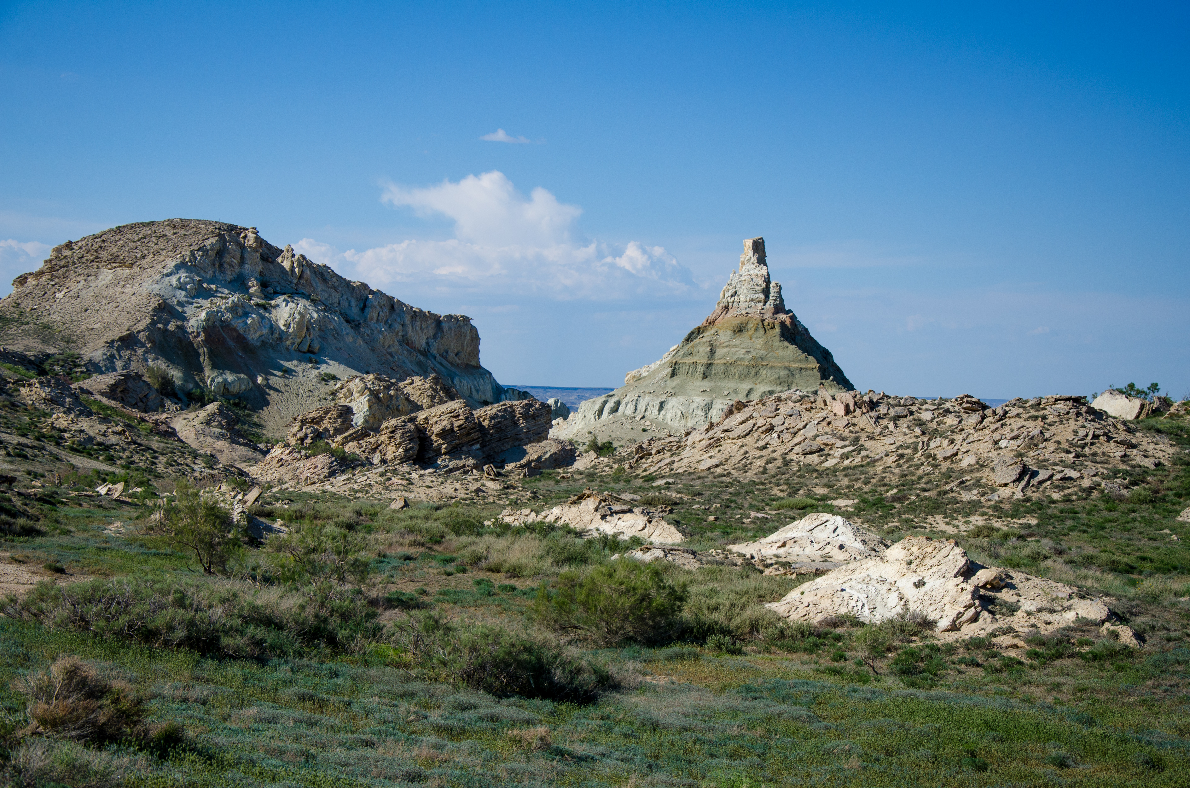


Full itinerary and detailed information about the trip.
Eco-Tour to the Aral Sea (2 days and 1 night)
BEST CHOICE
BEST PRICES
RELIABLE TEAM

Slide 2

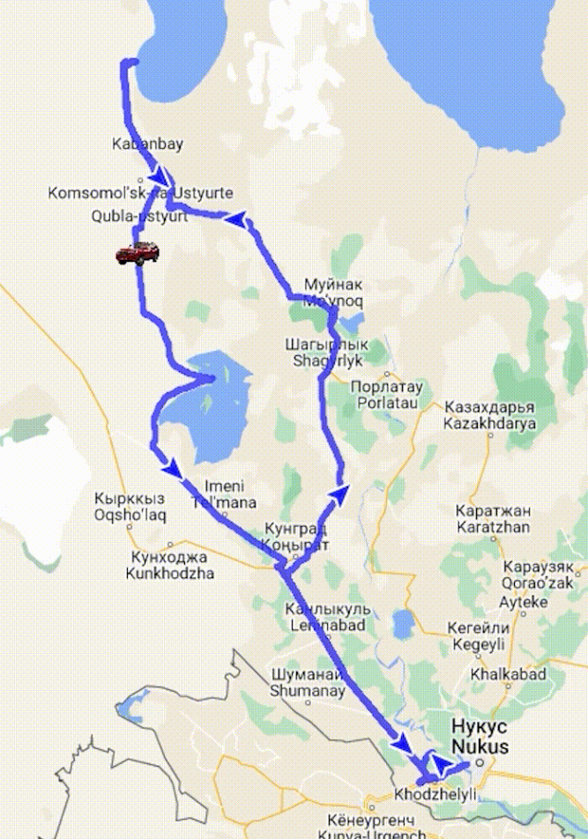
Trip itinerary
Duration:
2 days/1 night
Tour season:
Year-round
Total distance:
More than 800 km
Meals:
4 times
Transport:
Off-road vehicle 4x4

Slide 3

Day 1: Nukus - Muynak - Ustyurt Plateau - Aral Sea
Start point:
Nukus city (Railway Station, Airport, Hotel, etc.)
This tour promises unforgettable experiences, immersion in history and unique nature, as well as cozy nights in yurts. Visit the Aral Sea and its surroundings feeling the magic of this area.
08:30 The extreme tour begins with departure from Nukus.
11:30 Excursion to the Ship Cemetery, a place covered with the history of violent ships on the Aral Sea. Visit to the Muynak State Museum of Local Lore, and the museum dedicated to the memory of the Aral Sea. According to the museum's program, you can watch a documentary video about the history of the Aral Sea and the life of Muynak.
13:00 Lunch in a cozy Guest house, where you will taste hot dishes from local cuisine.
14:00 Continuation of the tour through the bottom of the bygone Aral Sea to the Ustyurt plateau. Along the way, we can capture a view of the unique landscape, including the majestic canyons of Ustyurt, on a photo camera. On the Ustyurt Plateau we will get a lot of information about antiquity and a short stop at the cemetery of nomads.
17:00 The journey continues on the shores of the Aral Sea, where there is an opportunity to swim in the sea (in season), walk along the shore collecting shells.18:00 End of the day in a cozy yurt camp on the shore of the Aral Sea. Dinner in a traditional setting and a night in a cozy yurt will create a unique atmosphere. The camp has a shower with clean fresh water and a restroom.
Day 2: Aral Sea - Sudochie Lake - Kungrad - Mizdakhan Necropolis - Gaur Kala - Nukus
05:00-07:00 The second day meets with sunrise over the sea. This magical sight will immerse you in the atmosphere of an amazing morning. After that, a delicious breakfast awaits us, which will give energy for the whole day ahead.
07:00-08:00 Breakfast and preparation for departure.
08:00 We will make the return trip through the historical settlements from a different angle. The program includes a visit to Kurgancha–kala (XII-XIV centuries), a fortified trading post on the Great Silk Road.
10:30 The next stop is in the village of Kubla-Ustyurt, a small town built during the Soviet era. Here you will get information about the past life of the region. On the runway built during the Soviet period, you will capture an interesting building on a photo camera against the background of a rural landscape.
12:00 Guided tour of the old lighthouse, where the fire pointed the way to the village of Urga. We go down a steep descent to the abandoned fishing village of Urga near Lake Sudochie.This lake is a stopover for migratory birds such as pink flamingos, pelicans, ducks, geese and swans.
14:30 Lunch at a local cafe in Kungrad.
16:00 We will continue our journey with a visit to the historical and sacred complex of Mizdakhan (IV-II BC, XIII-XVI AD). Here we will see several interesting mausoleums, such as Mazlumkhan Sulu, Khalifa Yerezhep, Shamun Nabi, as well as Giaur-kala, a settlement of the Zoroastrian era (IV-III BC
17:30 We finish our extreme tour to the city of Nukus.

Slide 4
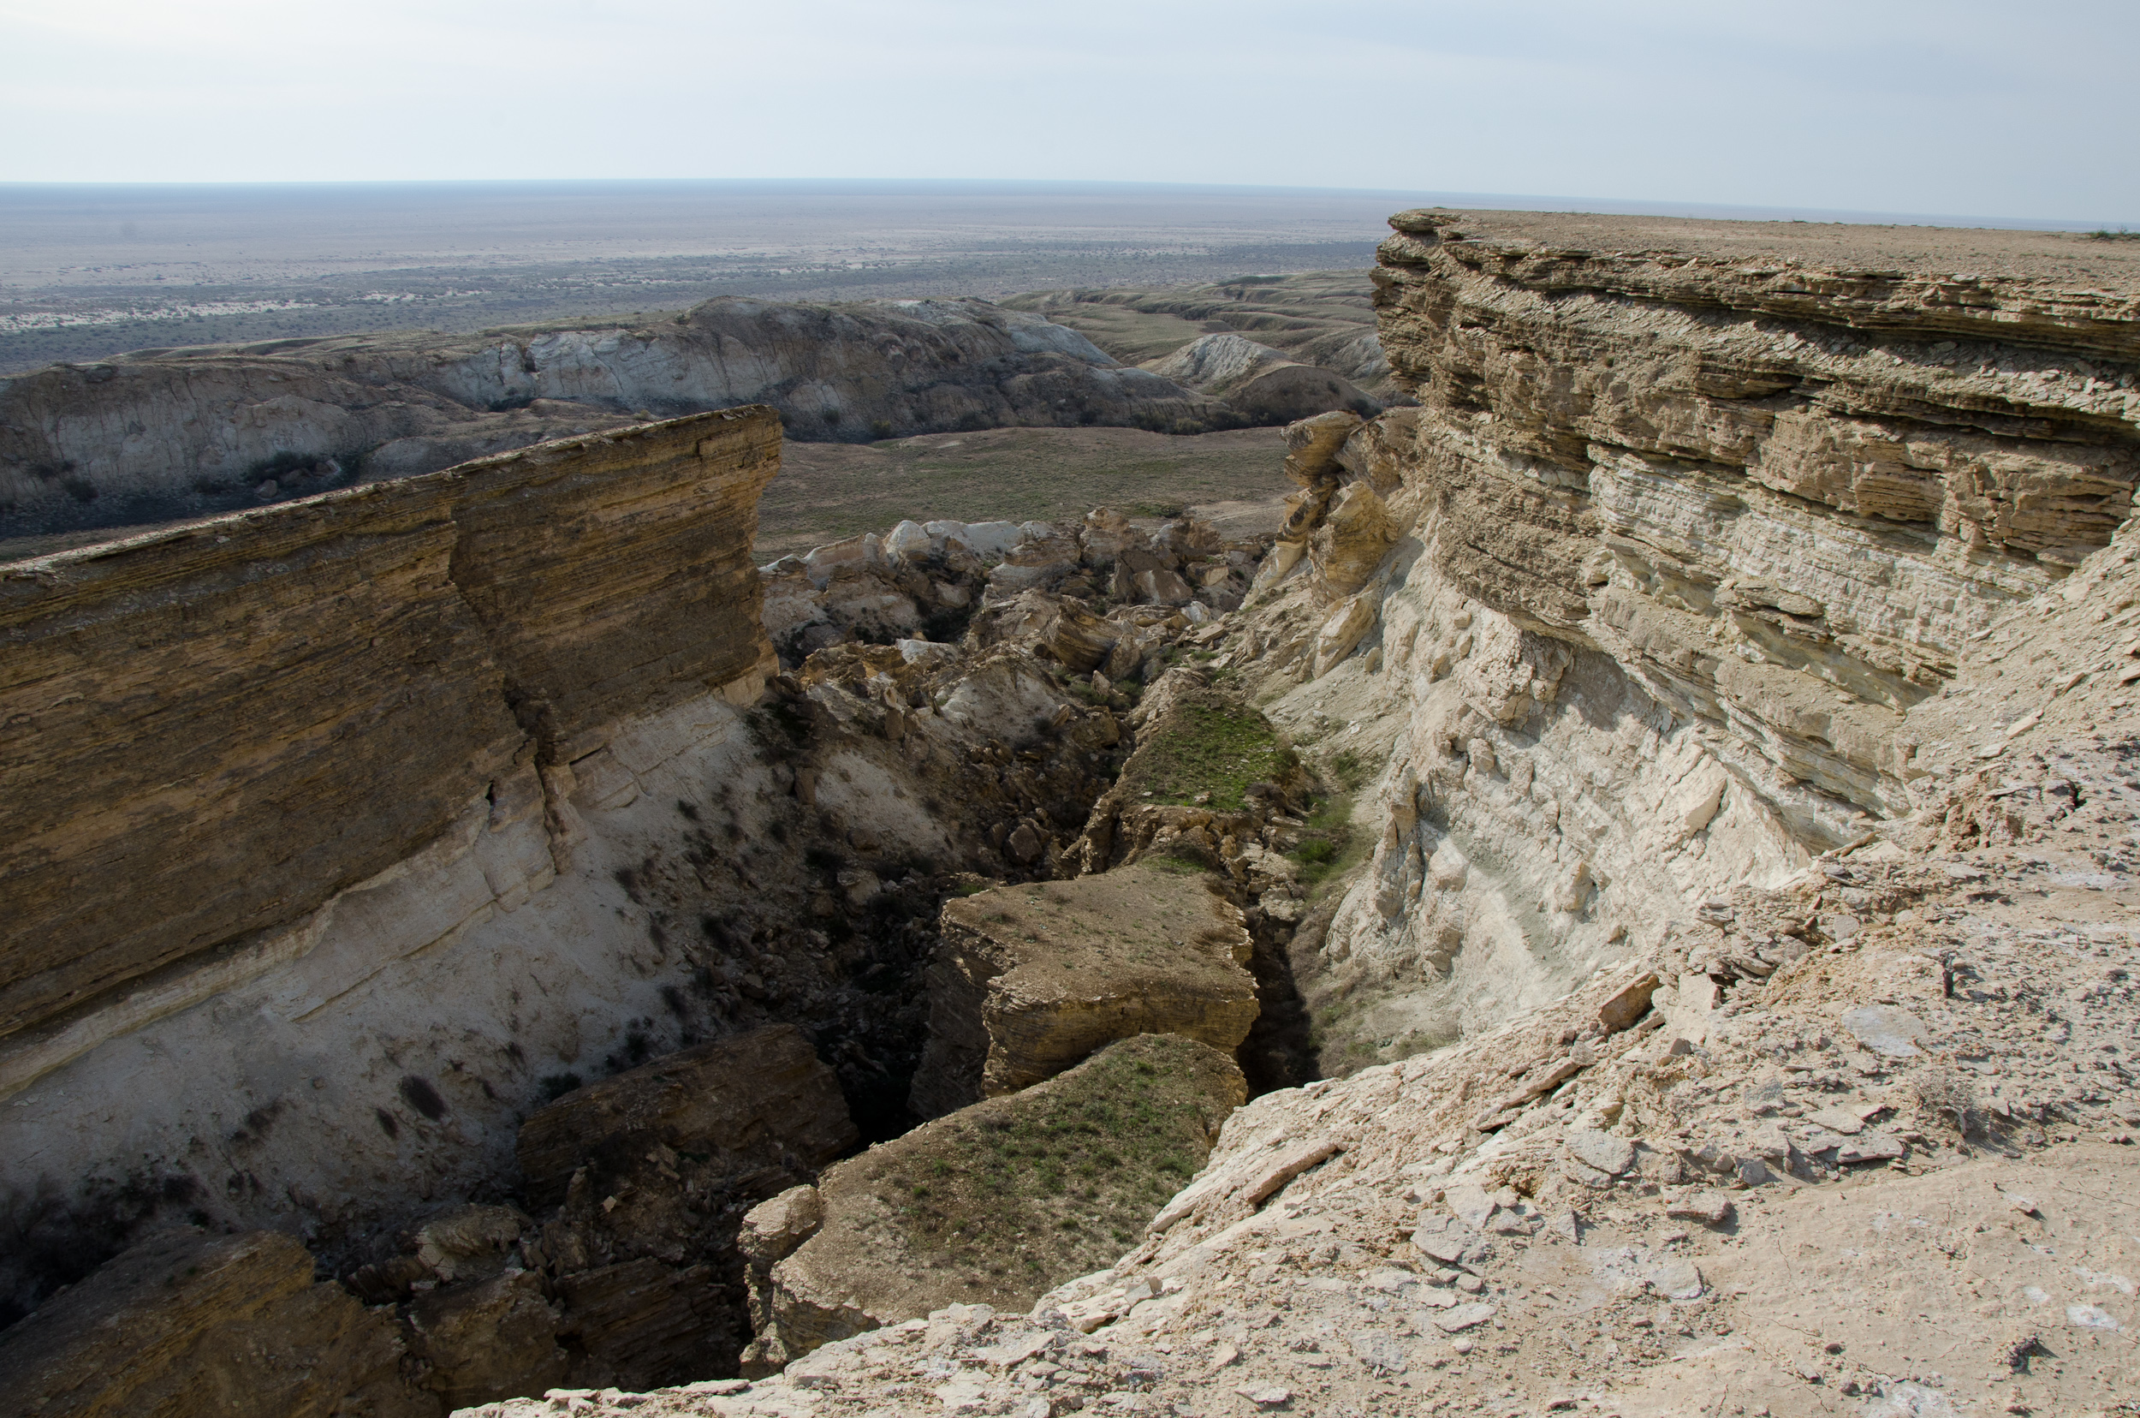
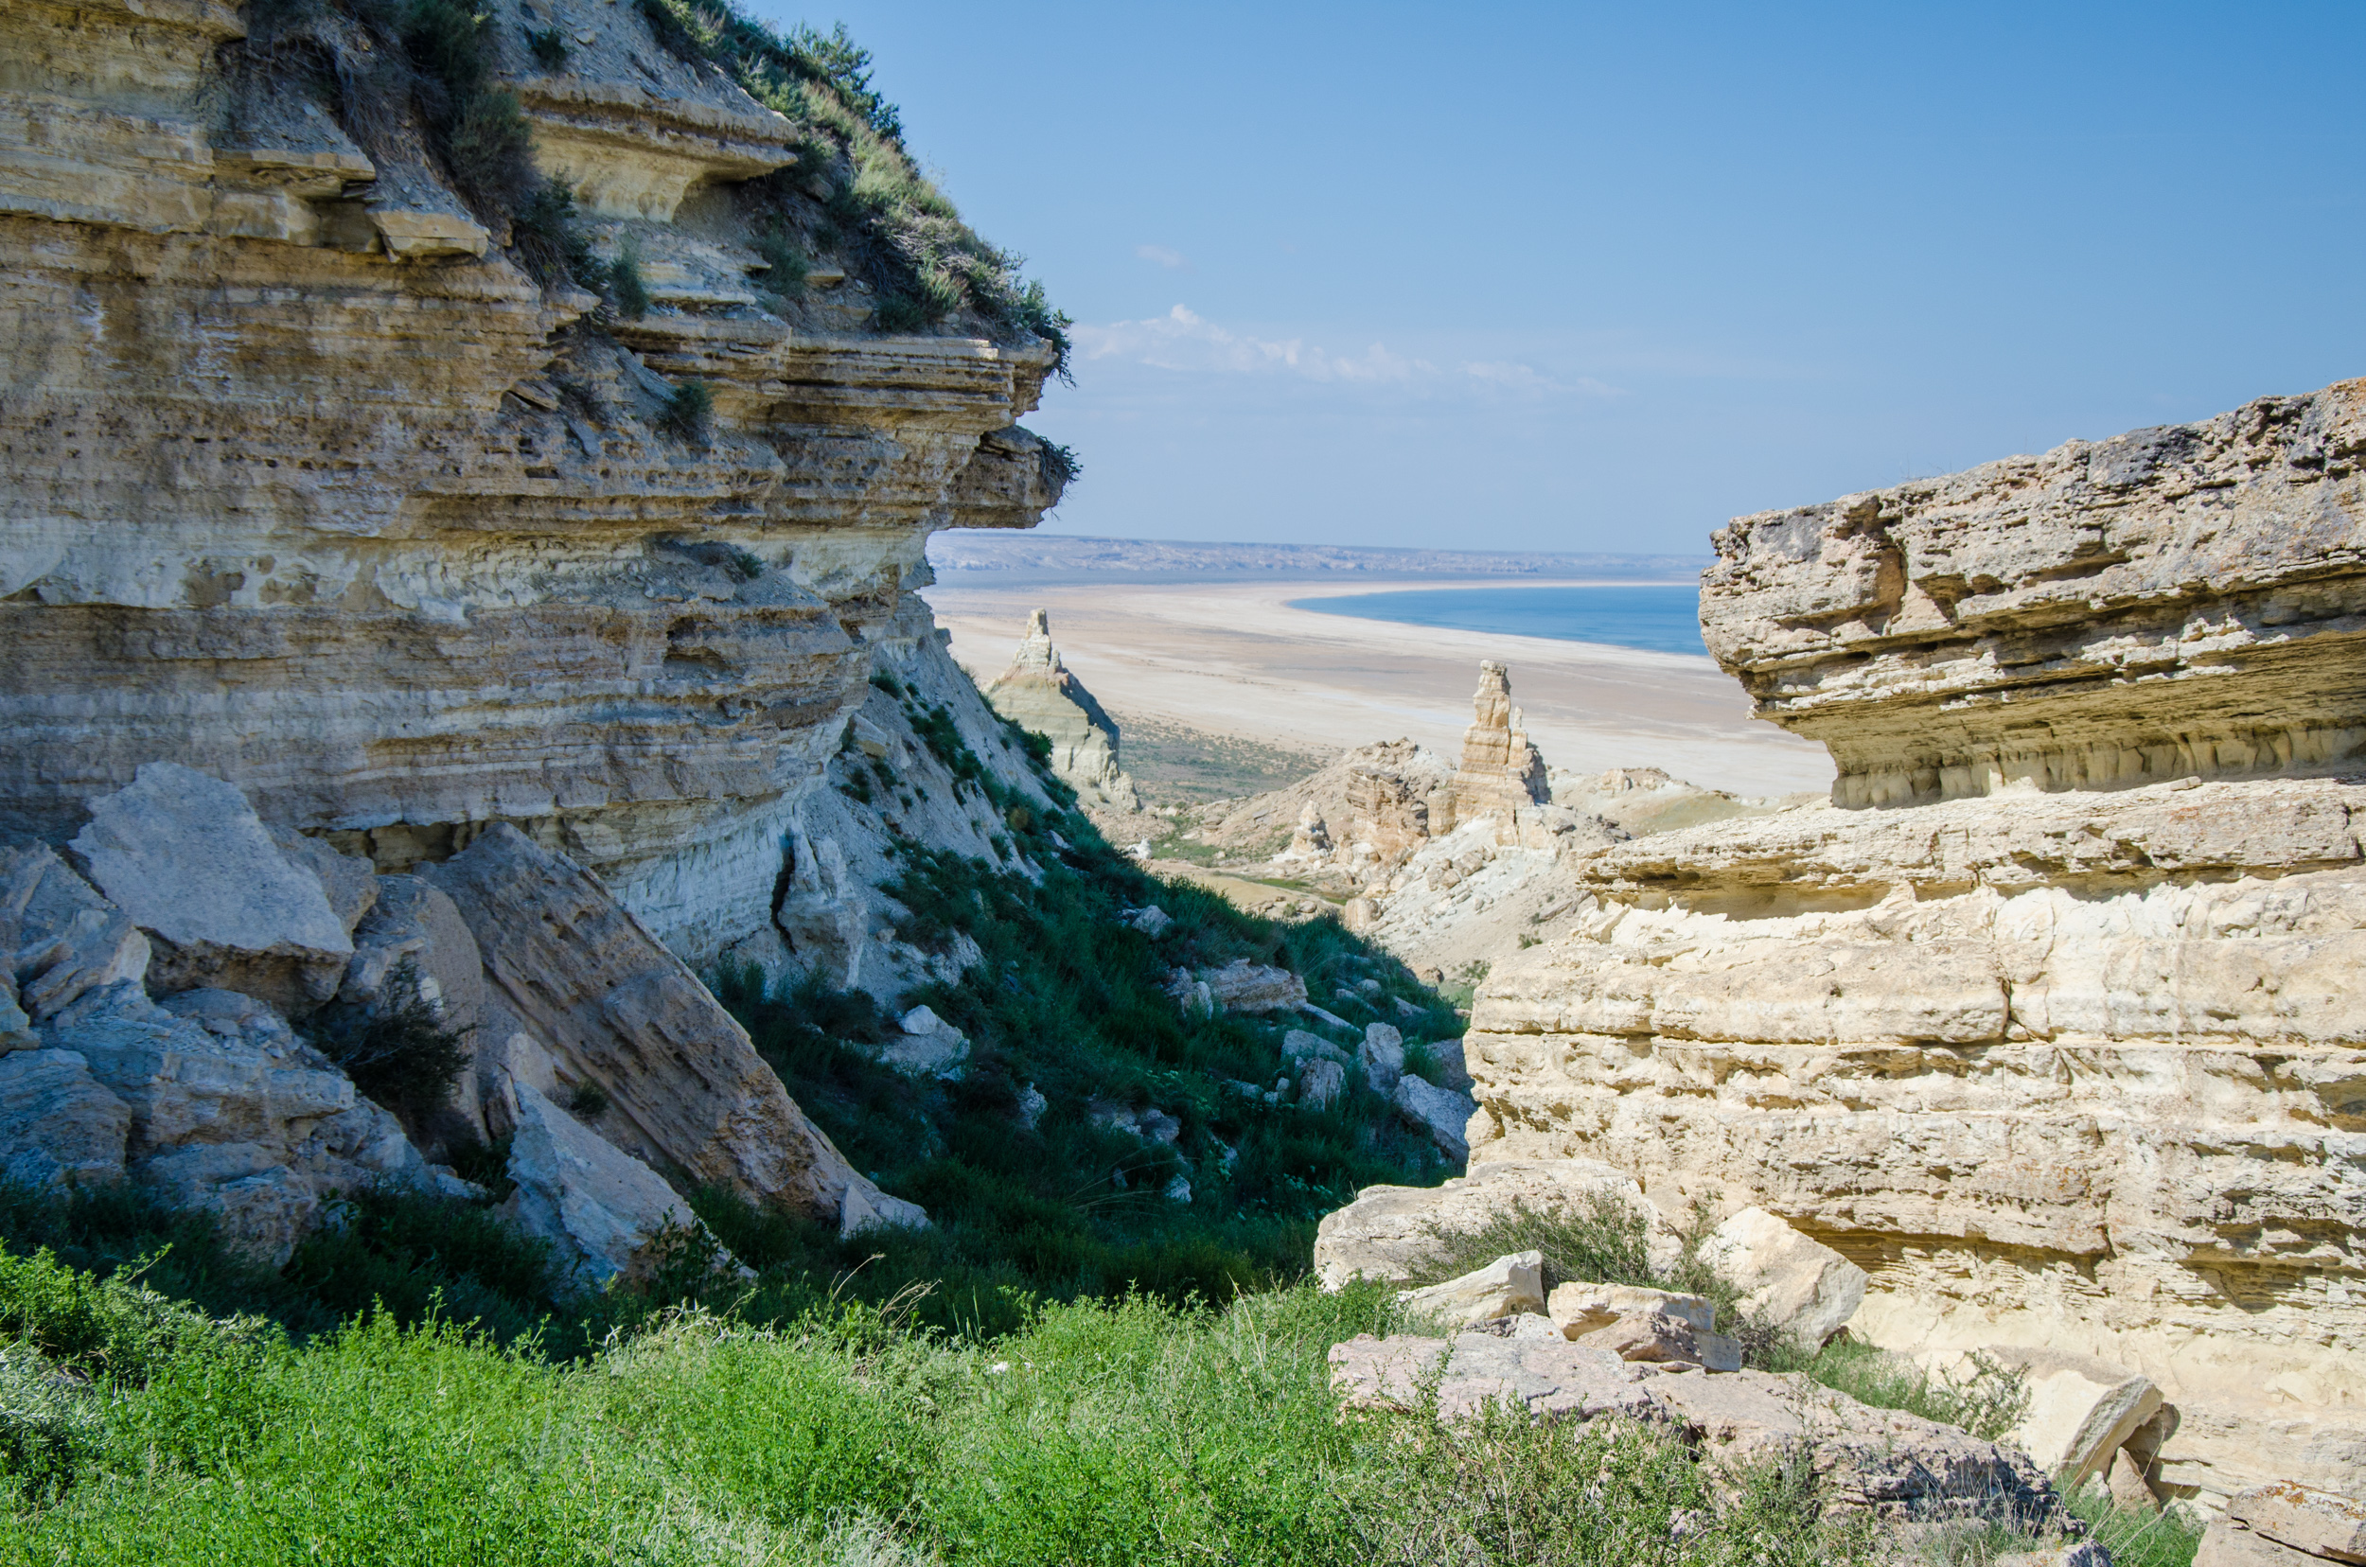
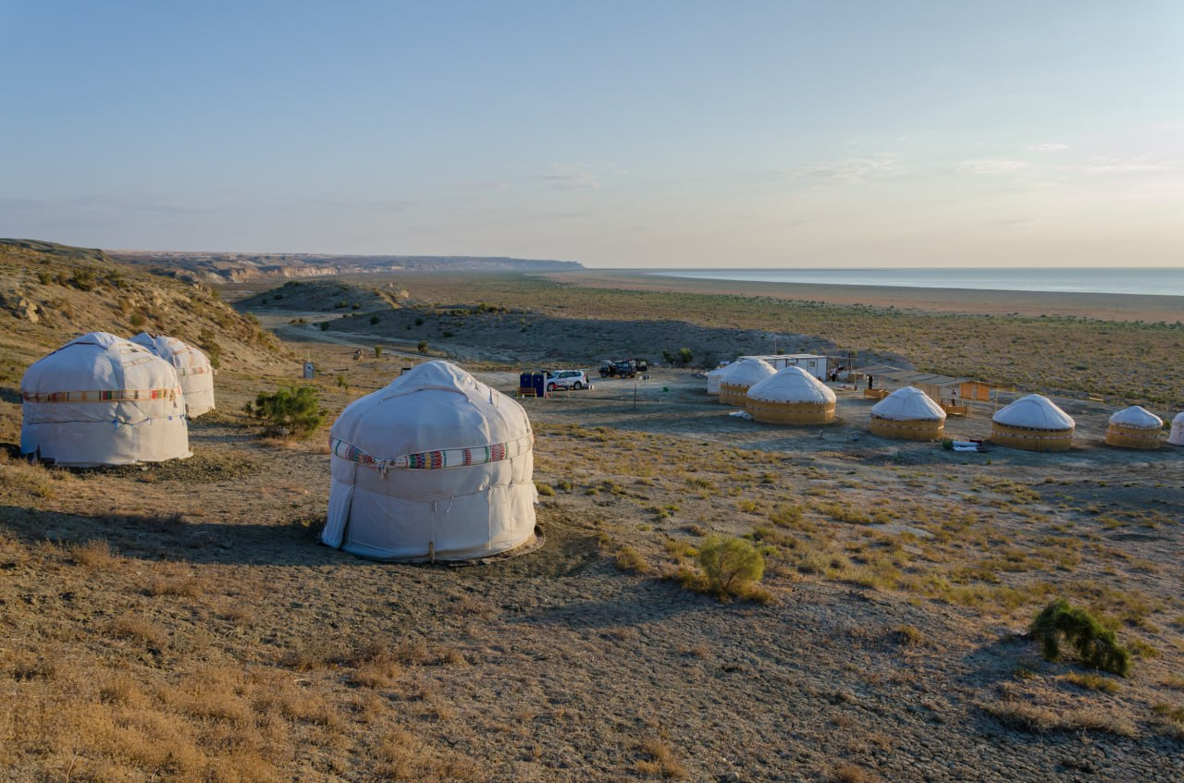
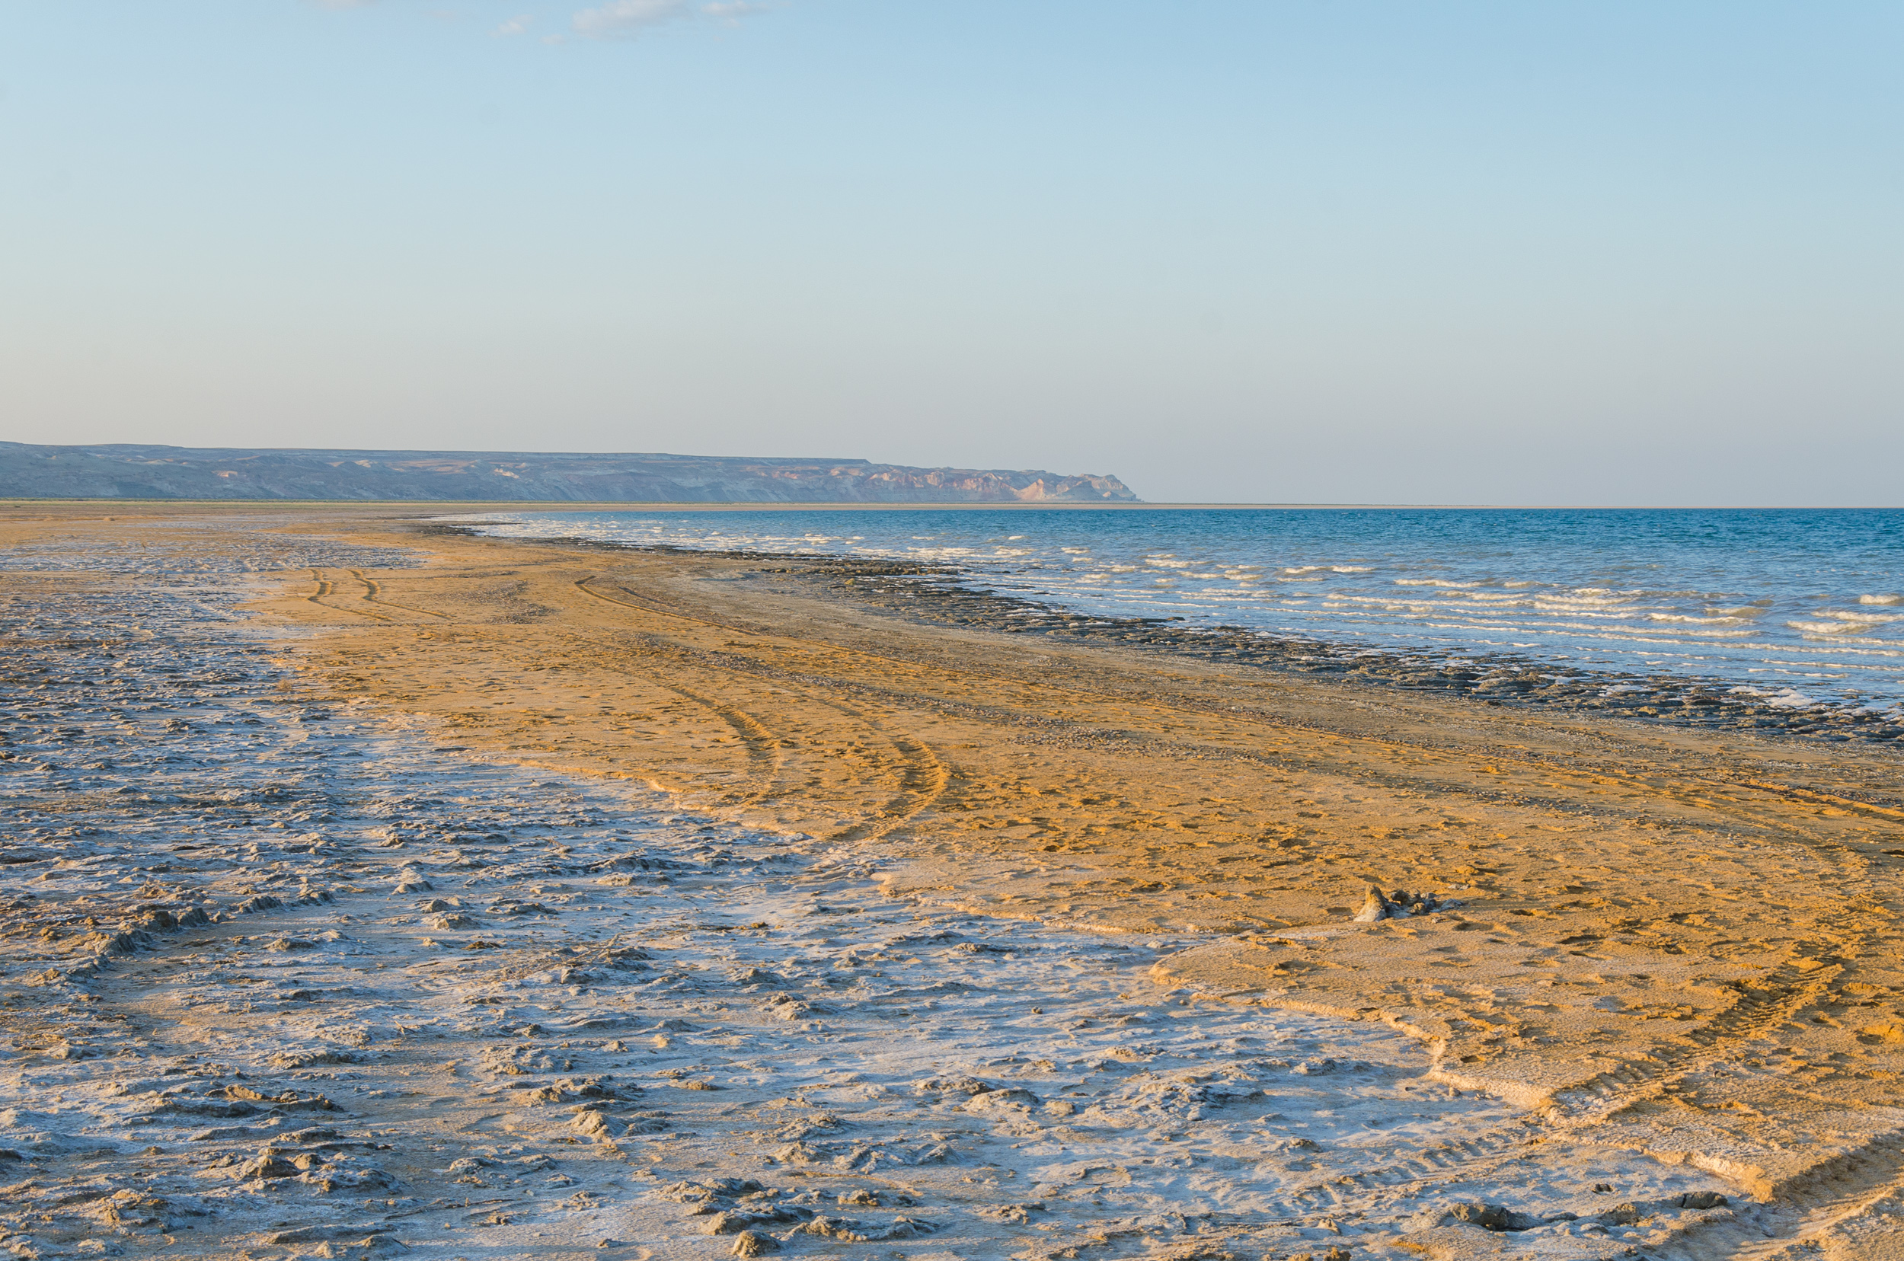
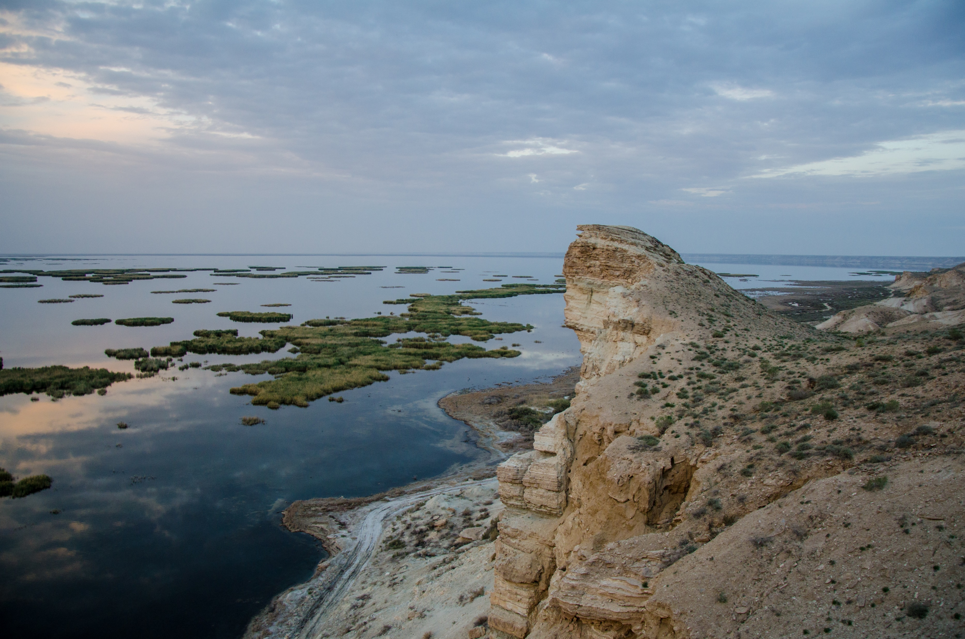
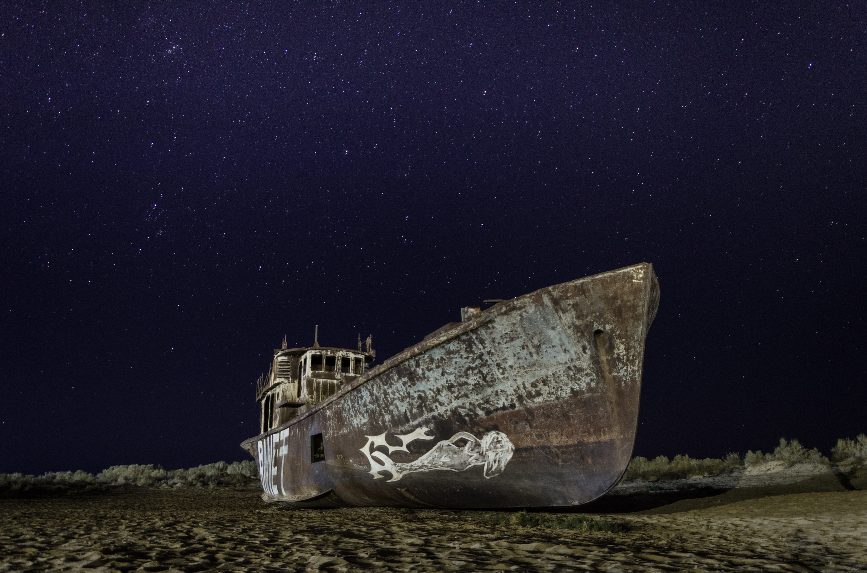
www.besqala.com

Slide 5
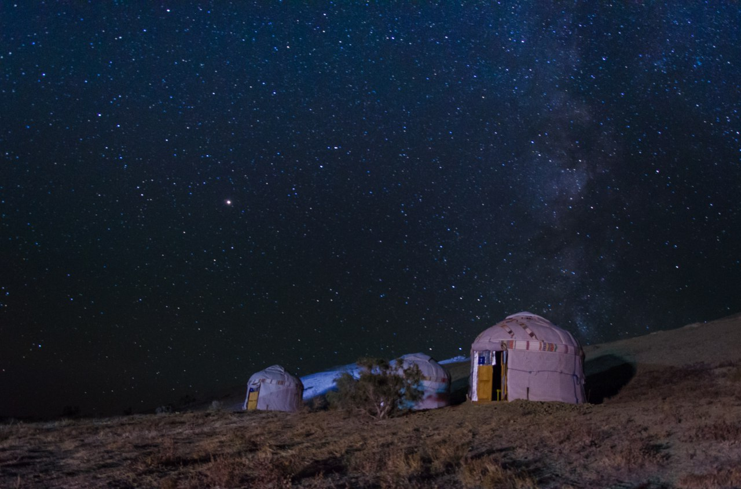
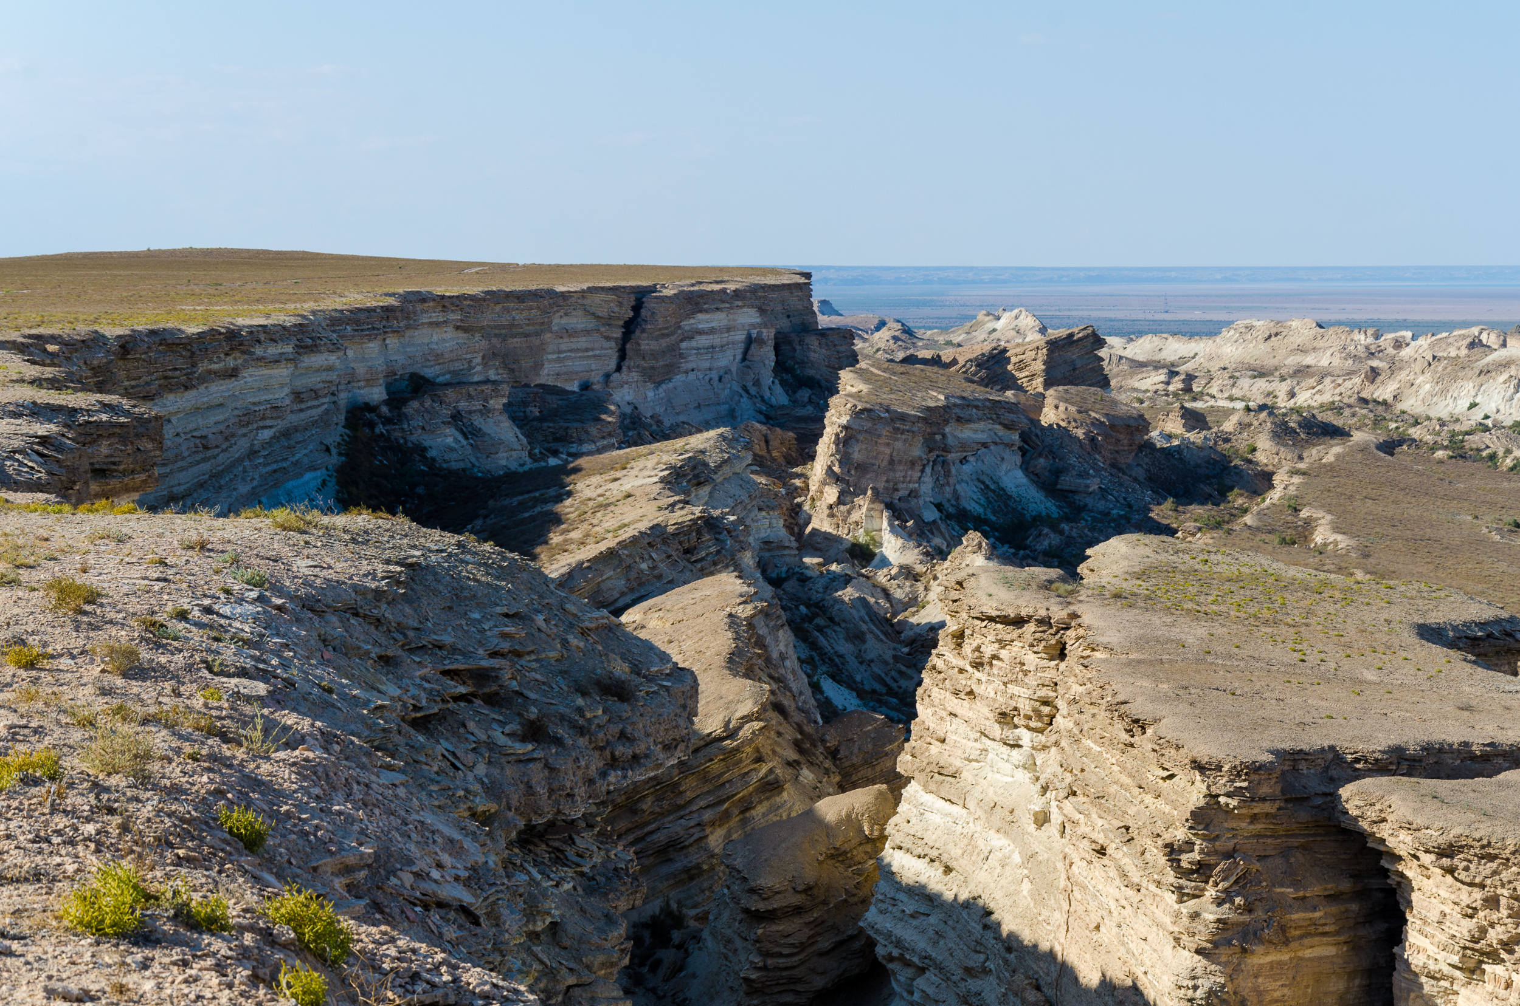
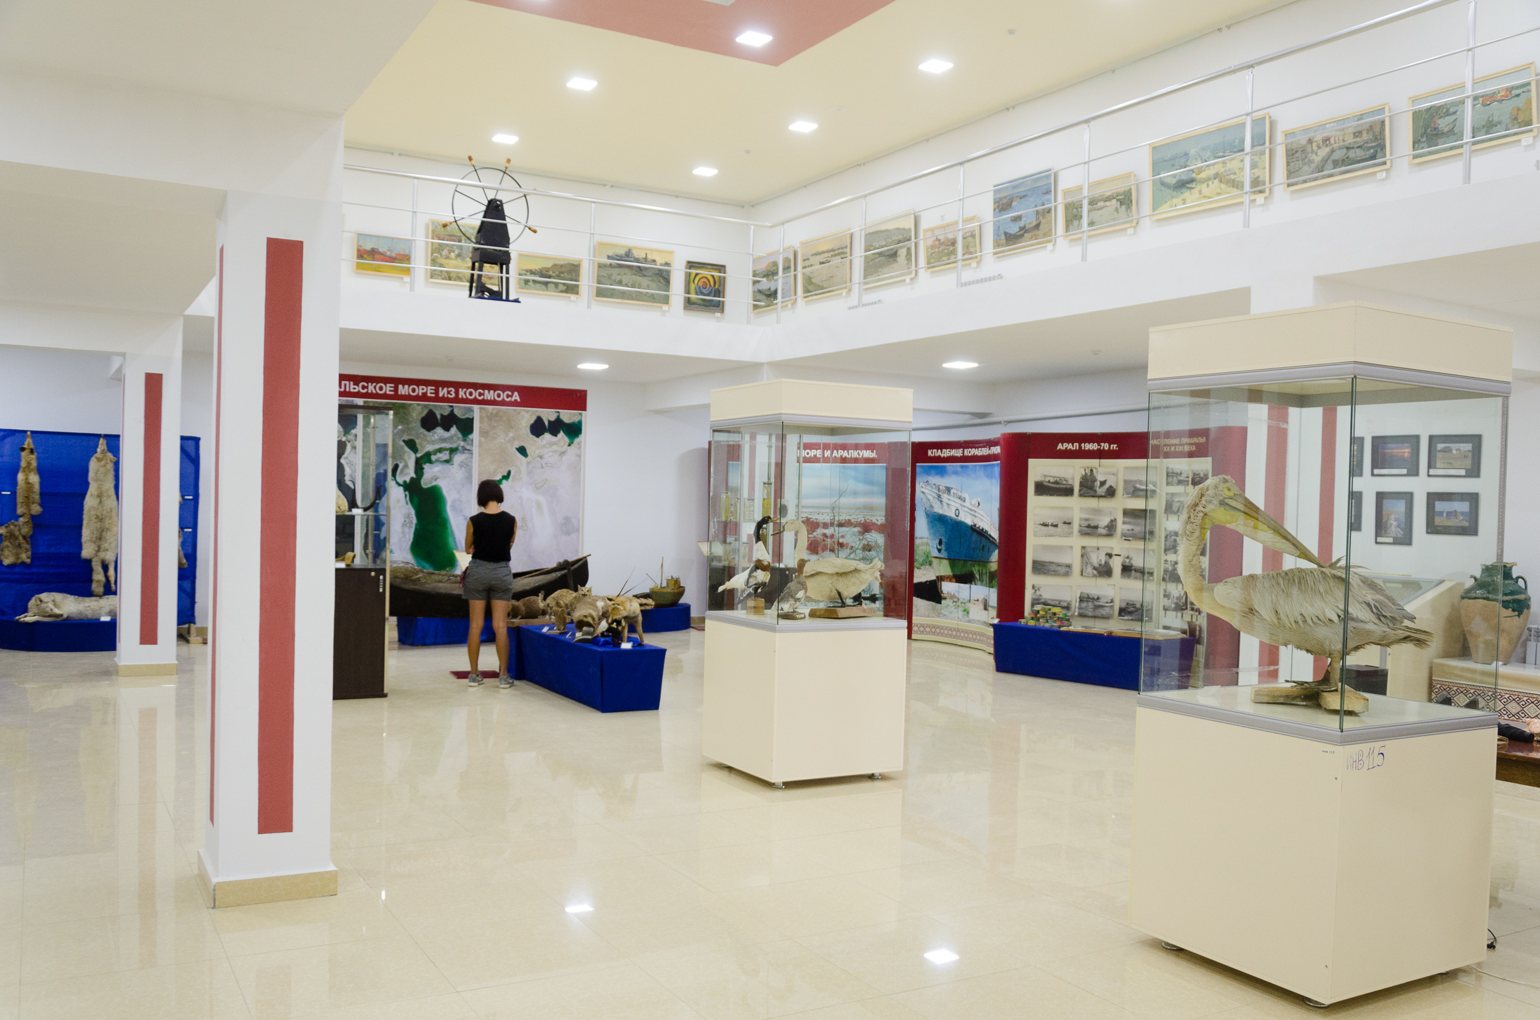
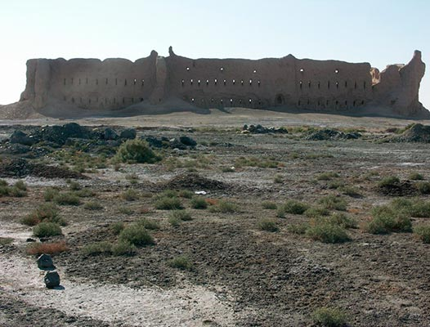
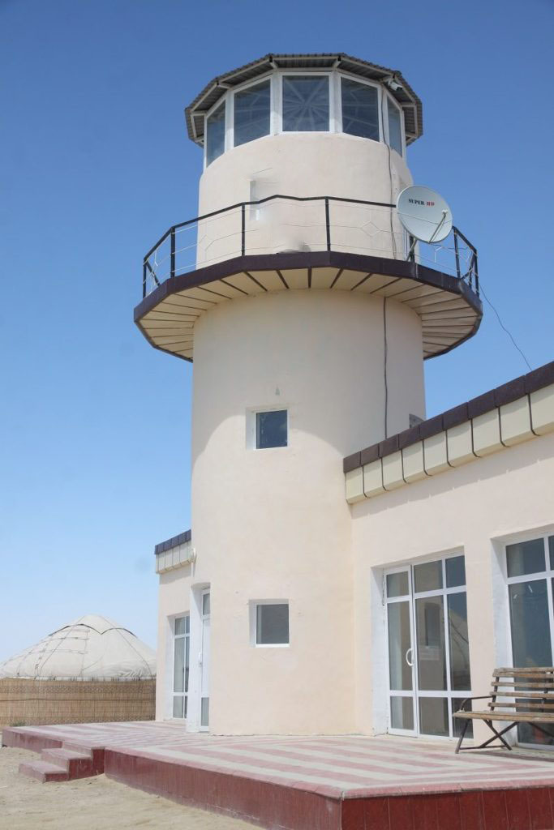
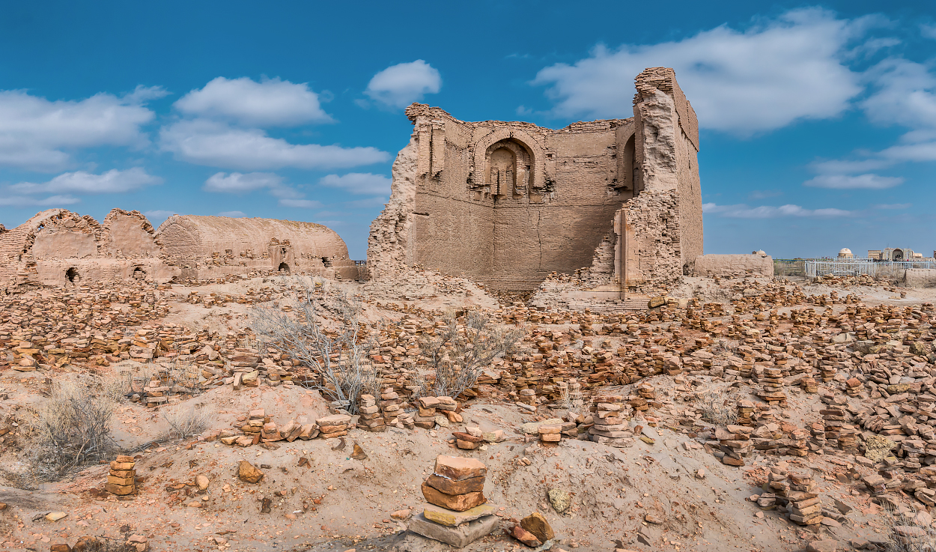
www.besqala.com

Slide 6
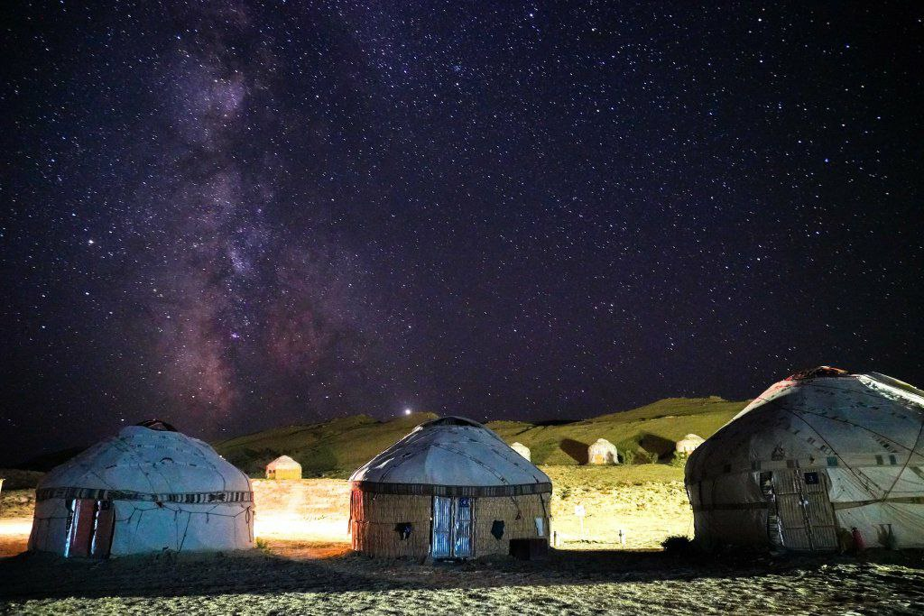
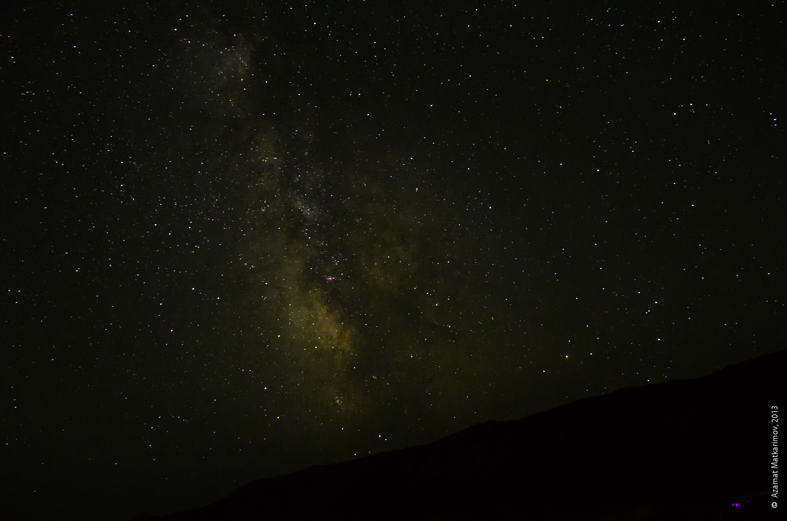
www.besqala.com

